Slide 1
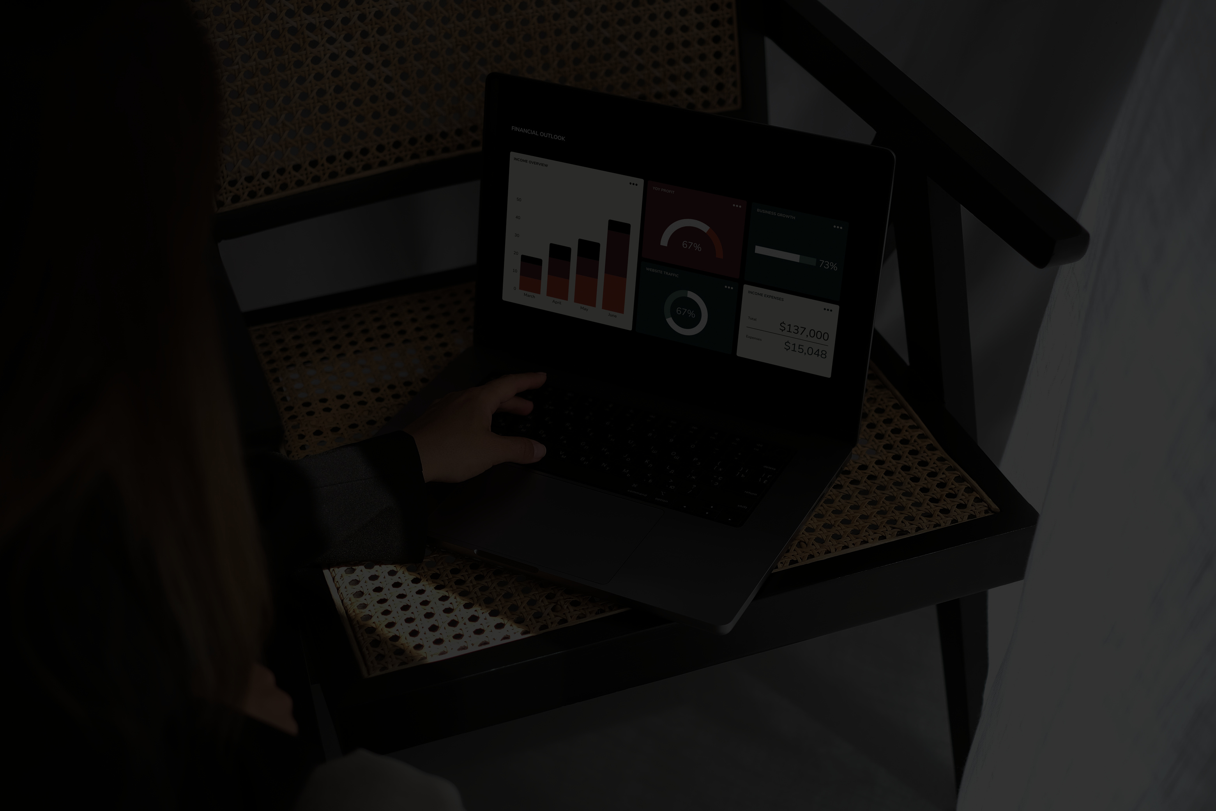
IT IN BUSINESS LAB (CL1001)
PROJECT PHASE II:
SHOPIFY STORE DATA ANALYTICS & DASHBOARD
STUDIO NEST
MEMBERS
SYEDA ALISHBA RAZA ADEENA WAQAS MUHAMMAD ABDULLAH MAAZ SHAH SYEDA RATBA
I25-5093 I25-5145 I25-5009 I25-5071 I25-5029

Slide 2
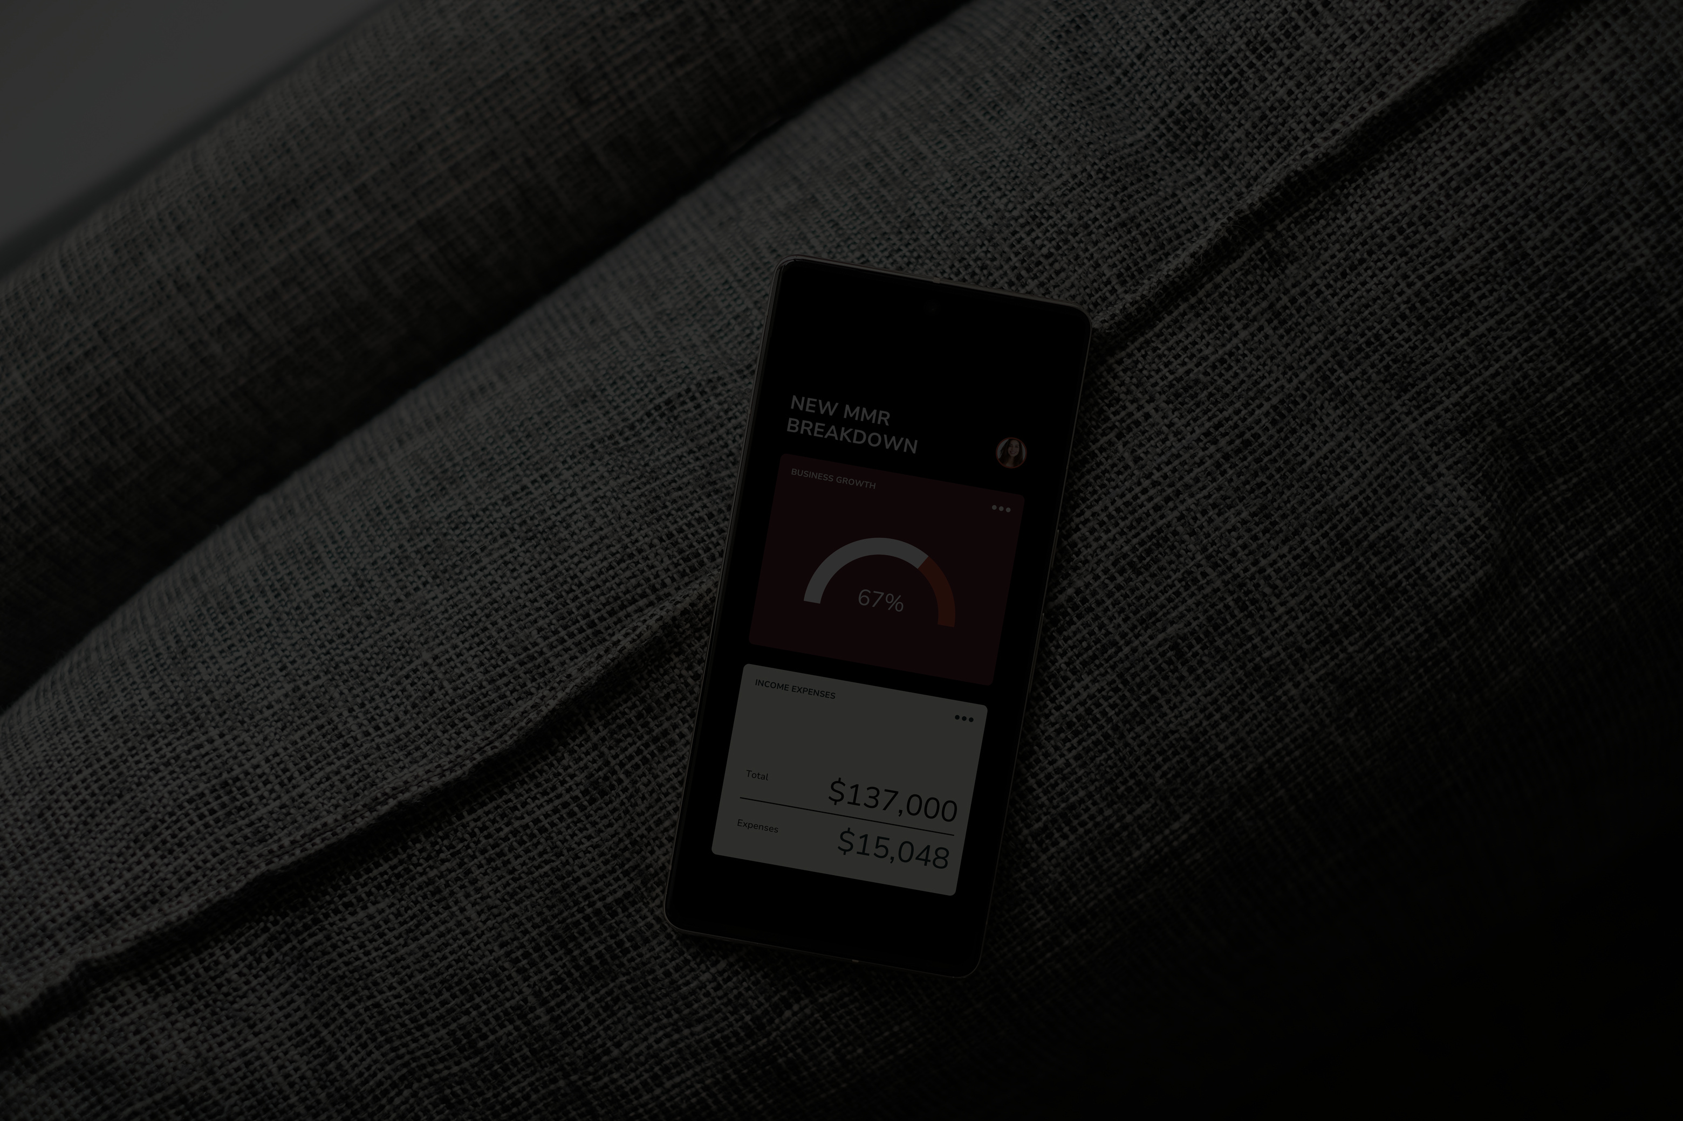
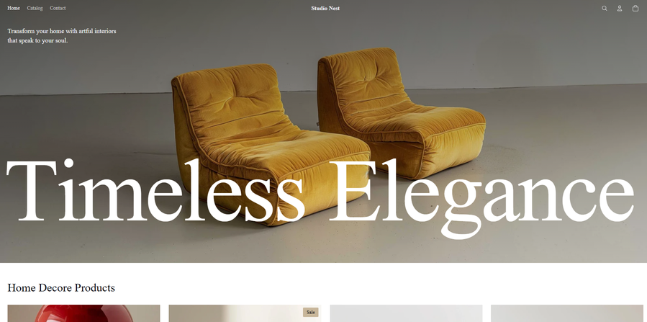
INTRODUCTION OF STUDIO NEST
STUDIO NEST IS A NICHE HOME DÉCOR AND LIFESTYLE BRAND LAUNCHED IN 2023.
The brand offers a curated selection of Wall art, rugs, mirrors, Cushions, lamps, decorative accessories, Small furniture pieces, and services such as Interior styling, Custom décor design.
ORDER ID, ORDER DATE
CUSTOMER CITY/REGION
PRODUCT NAME, BRAND
CATEGORY, MATERIAL
PRICE, QUANTITY
TOTAL SALES, PAYMENT METHODS
DATASET DESCRIPTION
THE DATASET CREATED FOR STUDIO NEST INCLUDES REALISTIC SHOPIFY-STYLE ORDER RECORDS COVERING:
Time Period: January – October 2025
Total Orders: 97
Units Sold: 197
The dataset mirrors actual Shopify exports used by online stores.

Slide 3
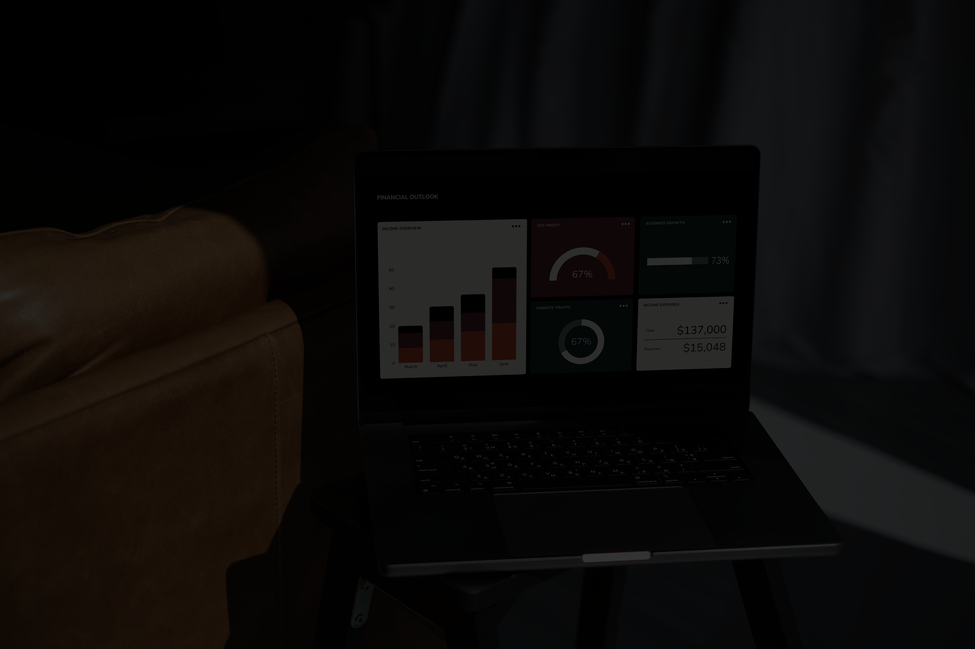
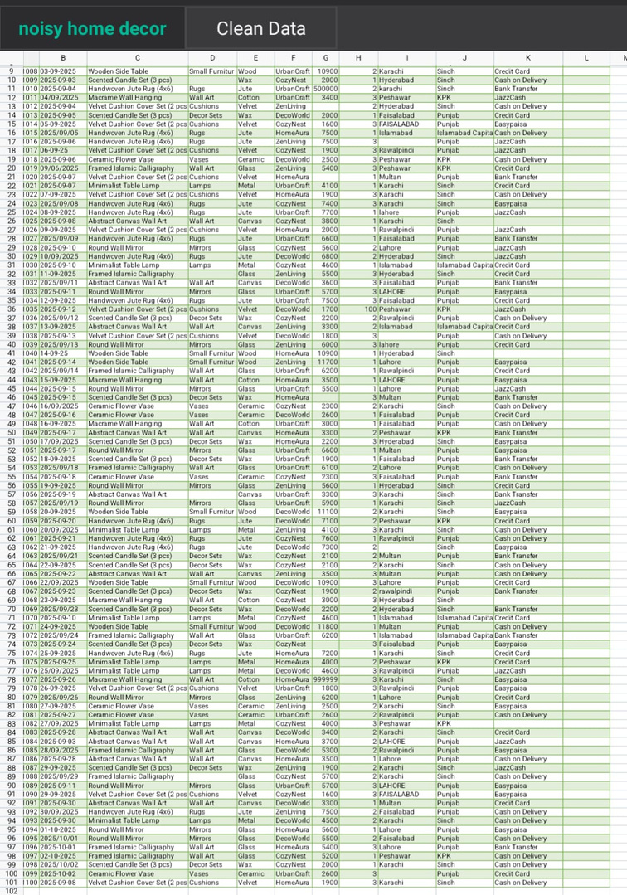
DATA QUALITY ISSUES
SCREENSHOT OF RAW DATASET
Realistic imperfections were added to the dataset.
Some Rows contained missing fields for City, Category and Fields.
In the raw excel sheet the column for category was left blank for some products before the mapping.
Presence of duplicate records.
Inconsistent formatting e.g. : city, prices, date formats etc.
Outliers
Mixed data types.

Slide 4
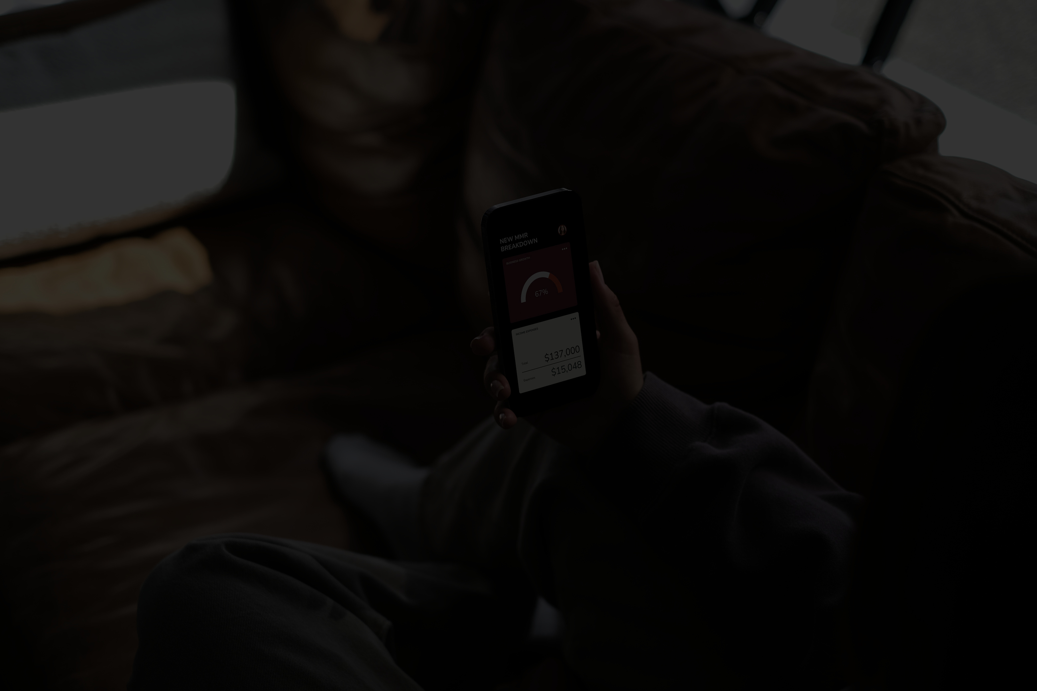
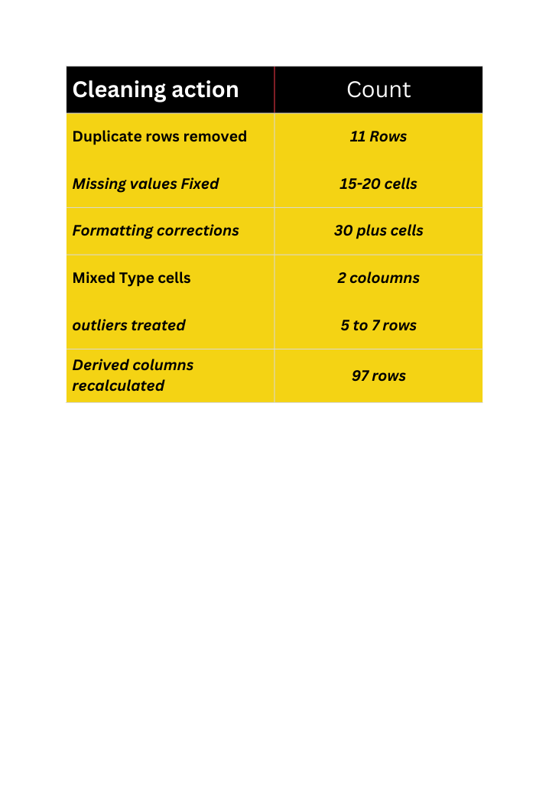
DATA CLEANING PROCESS
STATISTICS FOR THE CORRECT DATA
The raw dataset was cleaned using excel and Power BI
Duplicate row removed using “removed duplicates” in Excel
Unique order Ids validated
Missing values were fixed.
Formatting errors were corrected.
Outliner treatment
Derived columns were created.

Slide 5

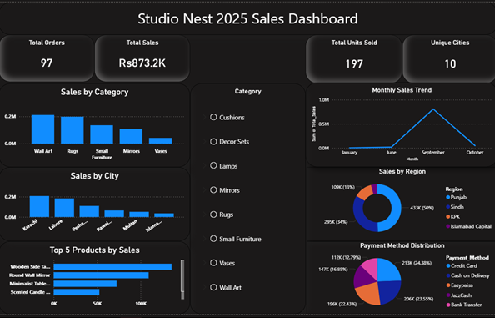
DASHBOARD
INCLUDED KPI’S
The included kpi’s had total 97 orders.
The total revenue generated was Rs. 873,200
Total 197 individual products were sold .
Total 10 cities were reached.

Slide 6
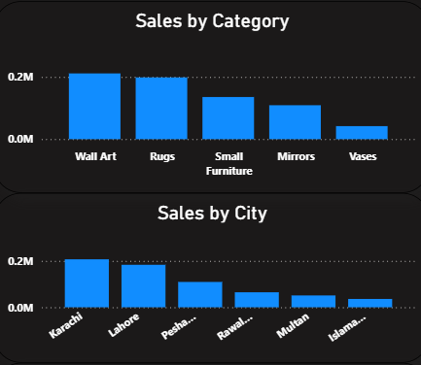
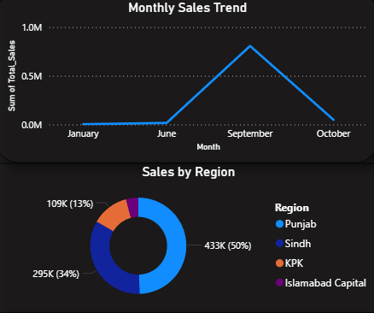
Key Visualizations
THE DASHBOARD INCLUDES INTERACTIVE SLICERS FOR CATEGORY, CITY, AND PAYMENT METHOD
Selecting any slicer dynamically updates all charts and KPIs
This allows quick comparison of sales performance across different segments
SCREENSHOTS FROM OUR PROJECT

Slide 7

BUSINESS ANALYSIS
Sales Insights
Customer Insights
Operational Insights
WALL ART , RUGS AND SMALL FURNITURE GENERATE THE HIGHEST SALES REVENUE
HIGH-MARGIN PRODUCTS CONTRIBUTE SIGNIFICANTLY TO TOTAL SALES
URBAN CUSTOMERS(KARACHI & LAHORE) PURCHASED THE MOST
CUSTOMERS PREFER DIGITAL PAYMENTS OVER CASH ON DELIVERY
SALES VARY SEASONALLY WITH A CLEAR SPIKE IN SEPTEMBER
Certain regions contribute significantly more to revenue

Slide 8
RECOMMENDATIONS
USING THE KEY FINDINGS FROM OUR SALES, CUSTOMER, AND OPERATIONAL ANALYSIS, THE FOLLOWING RECOMMENDATIONS ARE SUGGESTED.
WE RECOMMEND:
Increase marketing focus in Sindh and Punjab
Promote top-performing categories like Rugs and Wall Art
Offer seasonal discounts to boost low-sales months
Encourage digital payments through incentives
Introduce customer loyalty and referral programs

Slide 9
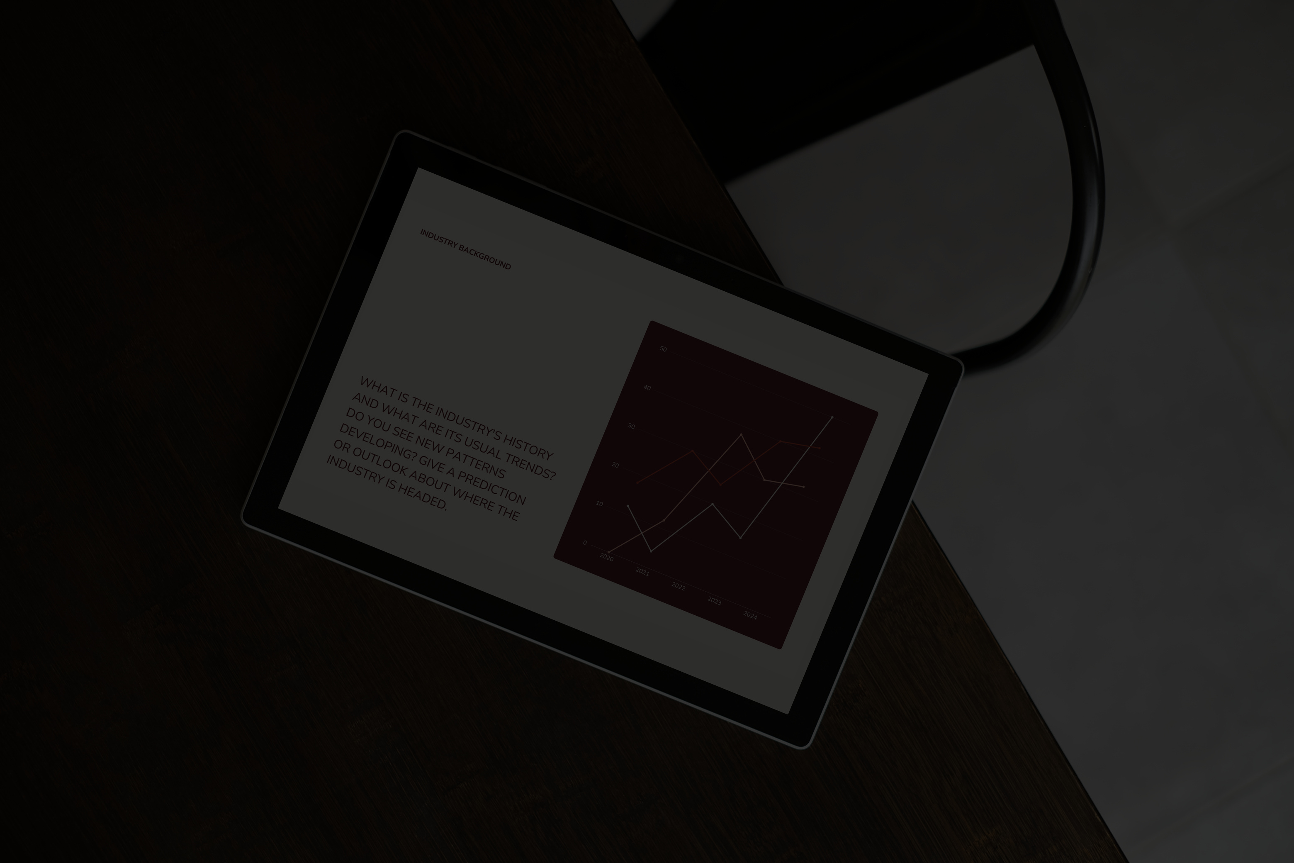
CONCLUSION
THIS PROJECT SUCCESSFULLY TRANSFORMED RAW SHOPIFY TRANSACTION DATA INTO MEANINGFUL BUSINESS INSIGHTS
Data cleaning and preprocessing improved the accuracy and reliability of the analysis
The Power BI dashboard enabled clear visualization and effective decision-making
Overall, data analytics can strongly support the future growth of Studio Nest
THANK YOU!

